Slide 1
Job Preparation Workshop
Vasanth S
GeeksGod

Slide 2
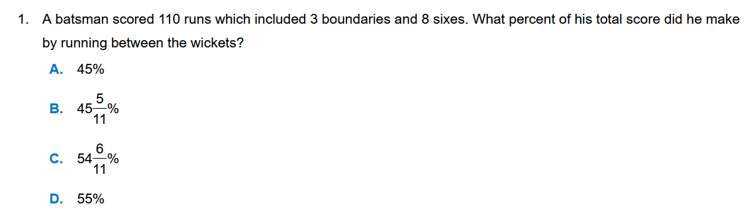
Percentages - Problems

Slide 3
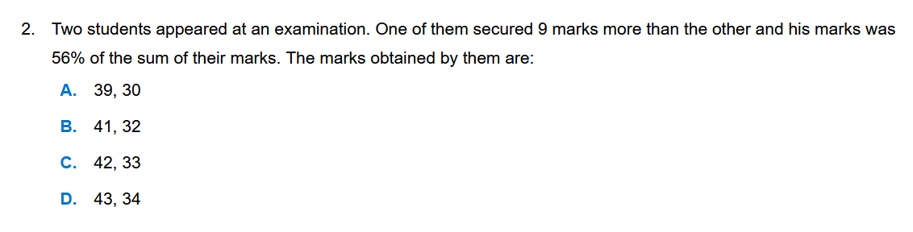
Percentages - Problems

Slide 4
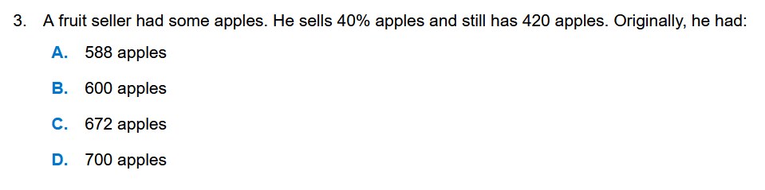
Percentages - Problems

Slide 5
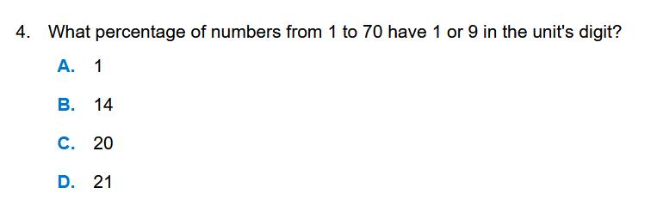
Percentages - Problems

Slide 6
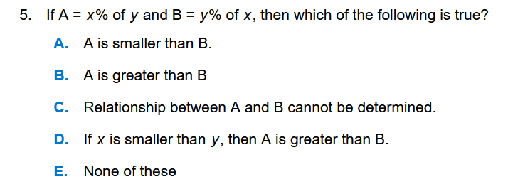
Percentages - Problems

Slide 7
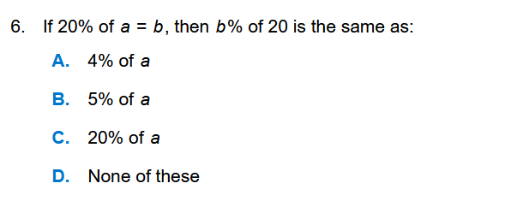
Percentages - Problems

Slide 8
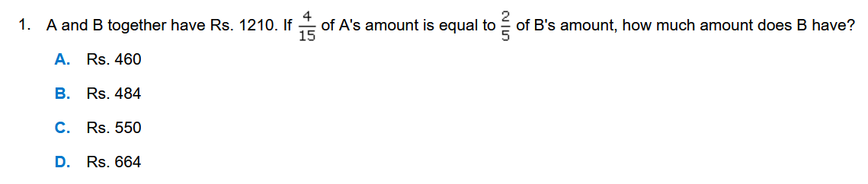
Ratio- Problems

Slide 9
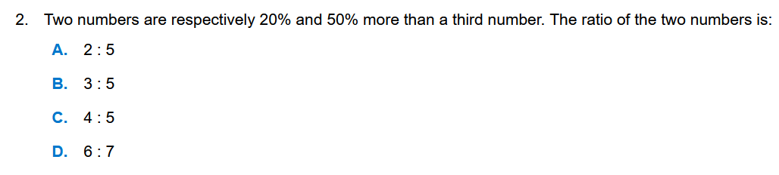
Ratio- Problems

Slide 10
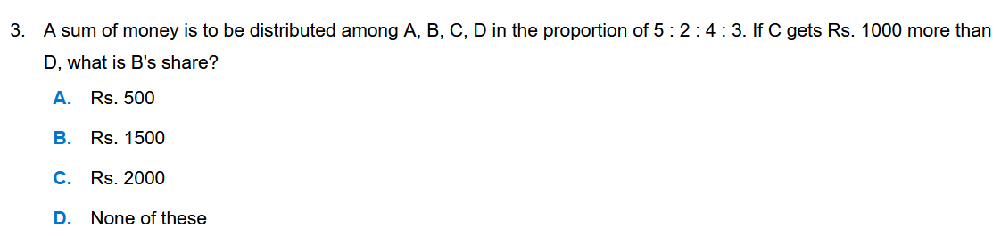
Ratio- Problems

Slide 11
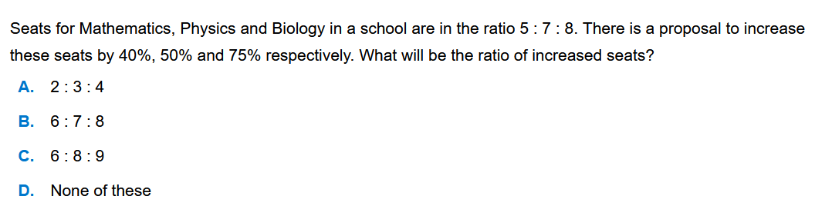
Ratio- Problems

Slide 12
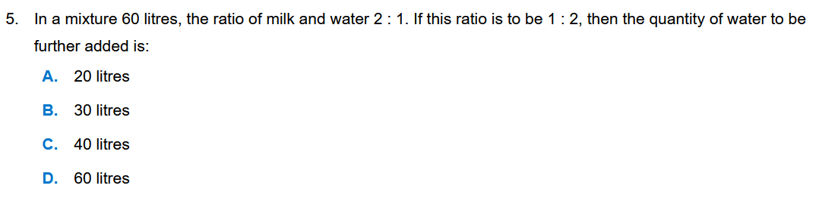
Ratio- Problems

Slide 13
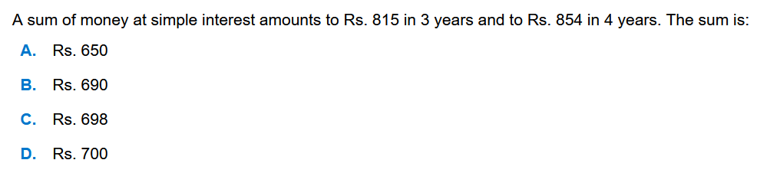
Simple Interest – Problems

Slide 14
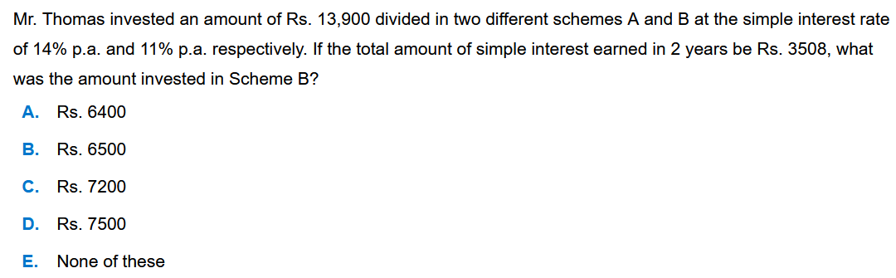
Simple Interest – Problems

Slide 15
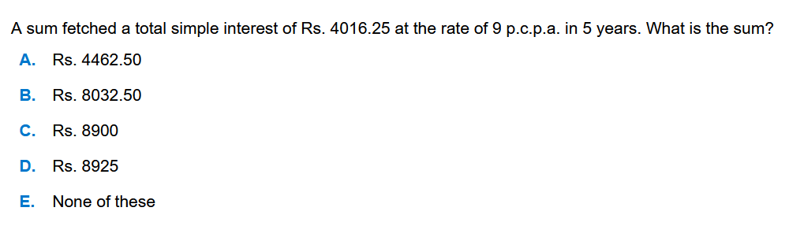
Simple Interest – Problems

Slide 16
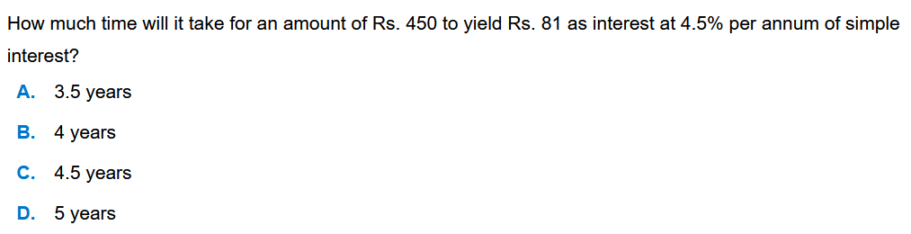
Simple Interest – Problems

Slide 17
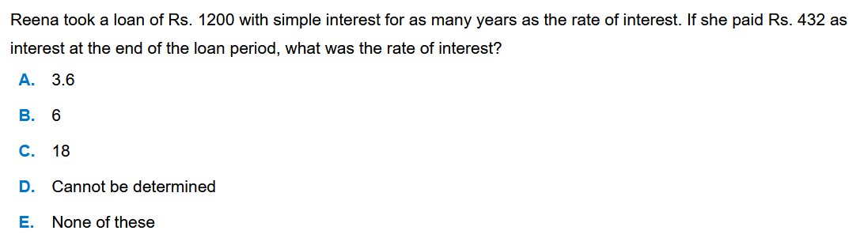
Simple Interest – Problems

Slide 18
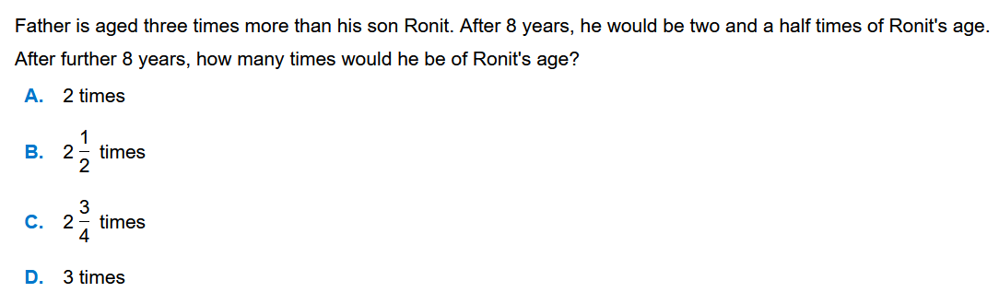
Age Calculation - Problems

Slide 19
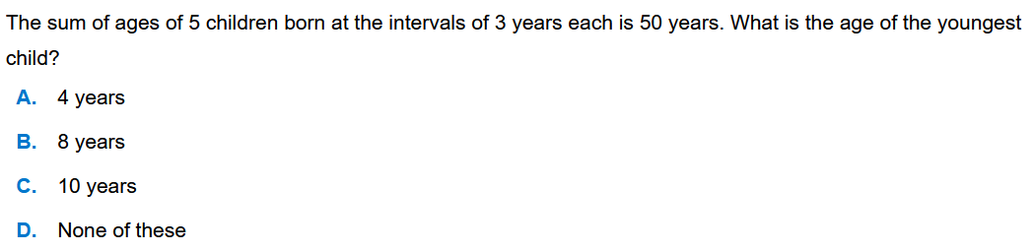
Age Calculation - Problems

Slide 20
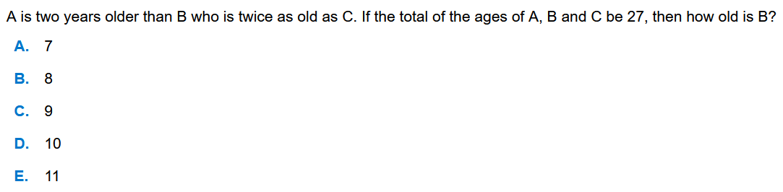
Age Calculation - Problems

Slide 21
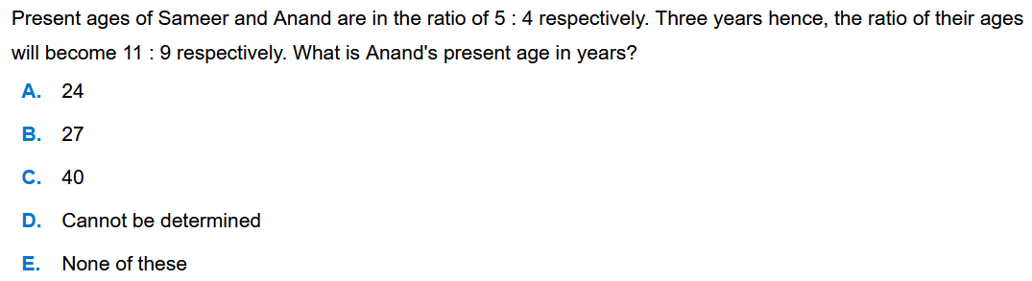
Age Calculation - Problems

Slide 22
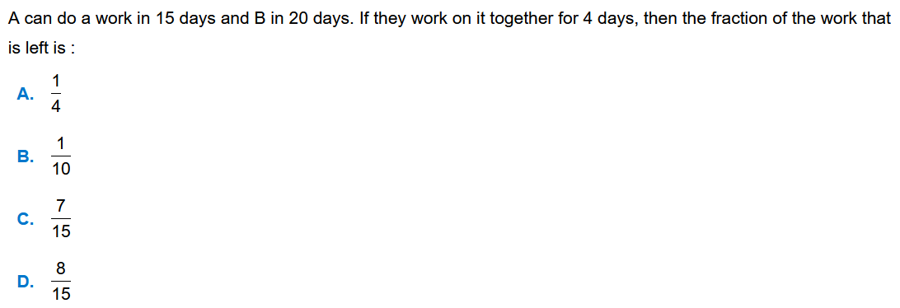
Work and Time

Slide 23
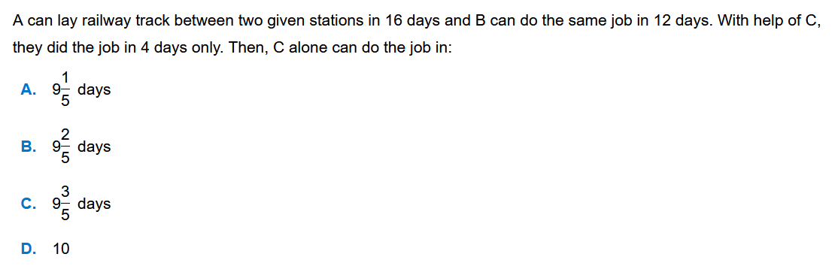
Work and Time

Slide 24
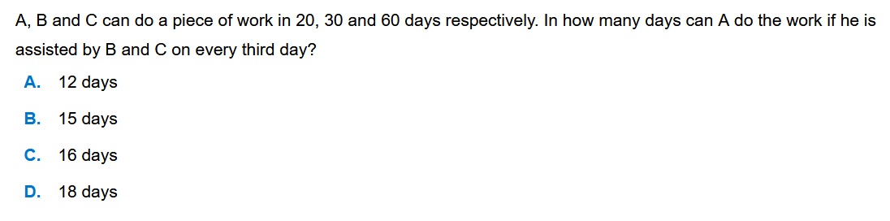
Work and Time

Slide 25
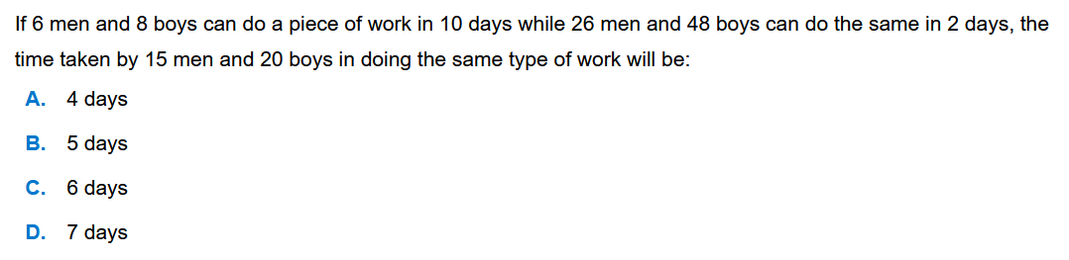
Work and Time

Slide 26
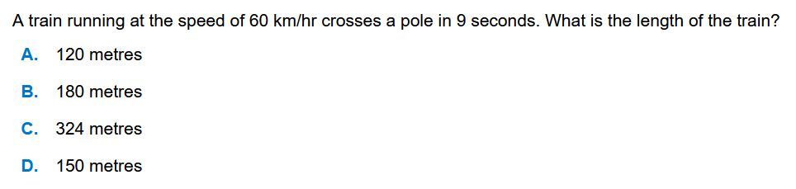
Train – Problems

Slide 27
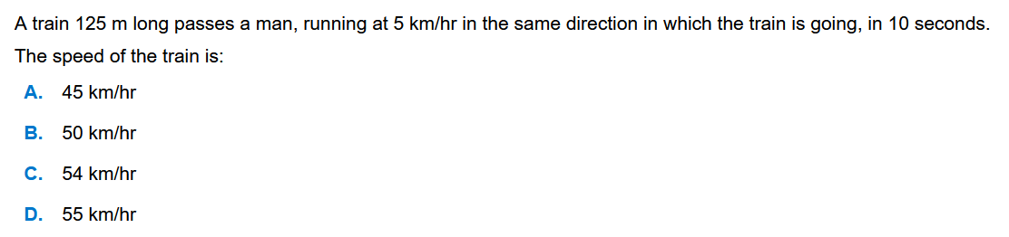
Train – Problems

Slide 28
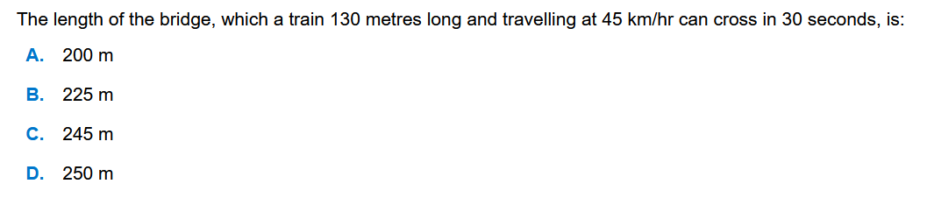
Train – Problems

